Slide 1
Discovery analysis of variables related to teachers

Slide 2
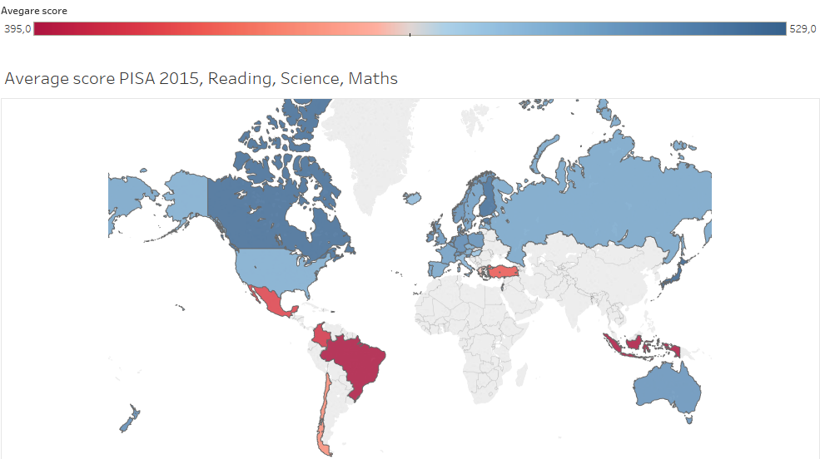
Average score PISA 2015

Slide 3
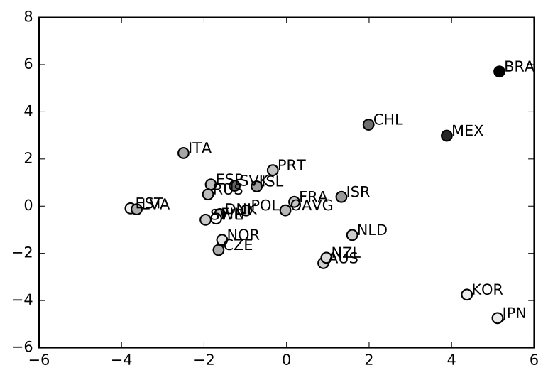
PCA of all the TALIS variables
PISA science 2015 score:
best
PC2
PC1

Slide 4
First axis of the PCA
explains 21% of the variance
Positive correlation:
Teachers having a mentor assigned
Class-time time spent on administrative tasks such as marking attendance
Negative correlation:
Age of teachers
Class-time spent on actual teaching and learning tasks
Non-
occidental countries
Eastern Europe countries
Western-Europe countries

Slide 5
Second axis of the PCA
explains 16% of the variance
Positive correlation:
Teaching time per week (hours)
Teachers who believe they can help their students to think critically
Teachers who believe they can help their students to value learning
Negative correlation:
Age of principals
Teachers who are mentors to another colleague
Completion of teacher education or training programme
Latino countries
European countries
Asian countries

Slide 6
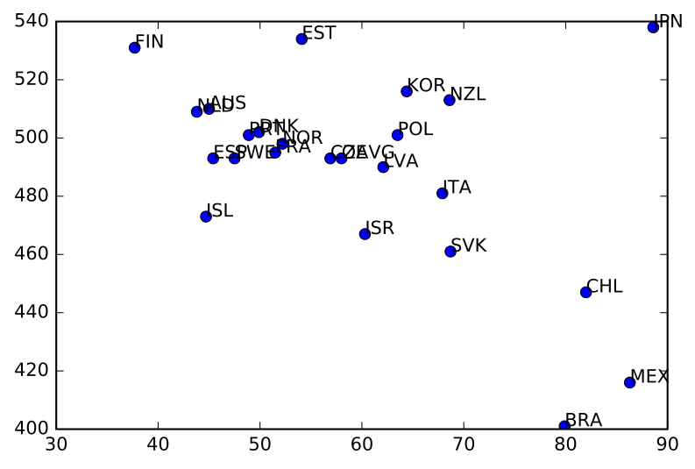
Variables related to feedback aren’t correlated with performance
Pisa science 2015 score
Is there a way to make feedback more efficient worldwide?
Teachers who report that feedback has improved their teaching practice (%)

Slide 7
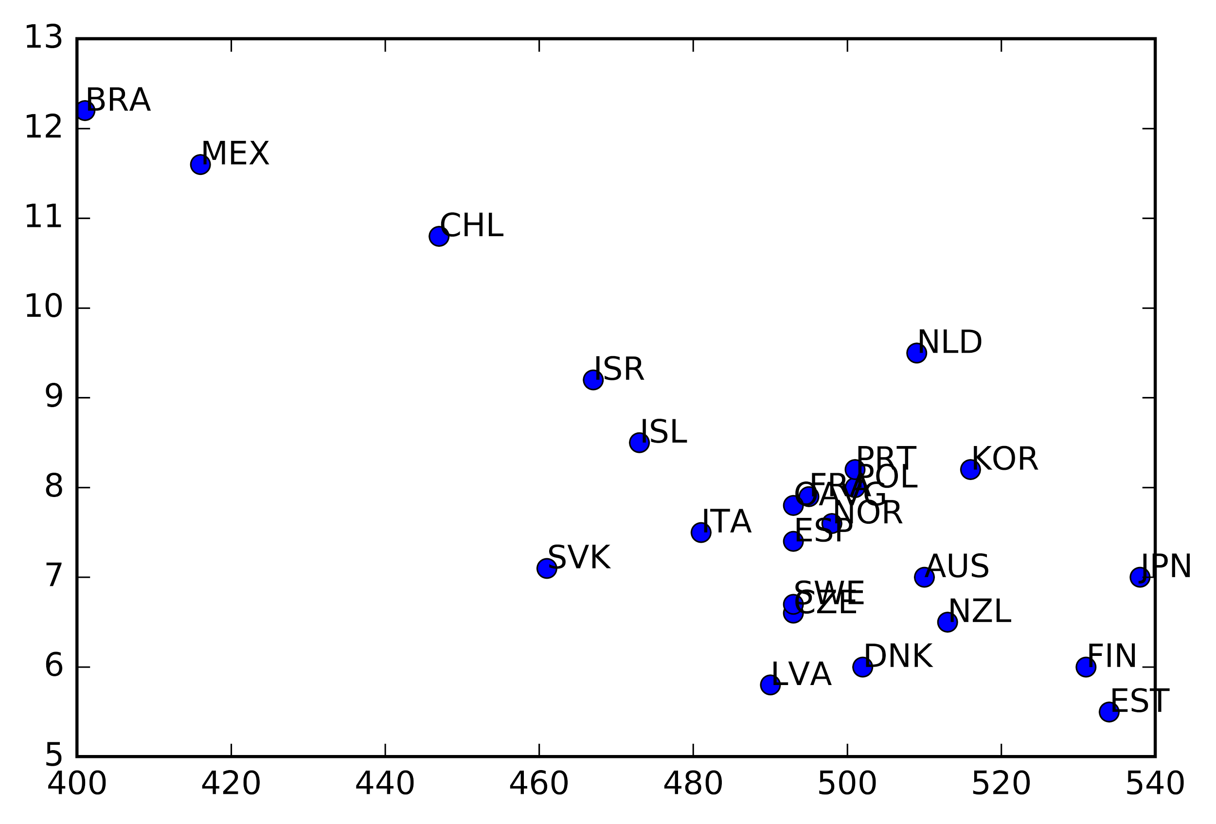
Administrative tasks
Pisa science 2015 score
Does it mean we should minimise administrative tasks?
Does it mean we should “flatten” hierarchy”?
Time spent on administrative tasks

